Slide 1
MMBU MFC Project Non-Electrical Workers’ Safety Hazard Assessment When Working under Overhead Transmission Lines Overview of Assessment

Slide 2
Presentation Outline
Purpose of Presentation
Scope Project
Background
Assumptions
Overview of Assessment Process
Other Activities
Description of Studies
Conclusions by Study
Recommendations by Study
Final Statement

Slide 3
Purpose of Presentation
This presentation provides an overview of the hazard assessment of non-electrical workers working in a “sorting work area” under existing and future 230 kV Transmission Lines associated the new Material Management Business Unit (MMBU) Material Classification Facility (MCF) in Surrey on 88th Avenue near Ingledow Substation.
This presentation provides information on what hazards were assessed, i.e.: the work itself, plus related hazards, and Induction, EMF, Step and Touch Potential, conductors dropping, and complete structure and structure/line failure, and how the requested hazard assessment was undertaken, plus the results of this assessment in terms of risk.

Slide 4
Purpose of Presentation con’t
The material in this Engineering Report is based on the following seven individual assessments listed below:
a Job Hazard Assessment (JHA) undertaken by Safety Engineering,
two Induction studies undertaken by Transmission Lines Engineering with being for the single double circuit line, and second study being for the two double circuit lines,
an EMF studies undertaken by Transmission Lines Engineering for the single and two double circuit lines,
a Step and Touch Potentials study to determine the Zone of Exclusions (ZoE) due to a fault event undertaken by Transmission Lines Engineering,
an assessment in terms of worker risk for the Step and Touch Potentials determined by the Transmission Lines Engineering Specialist Engineer and,
an assessment in terms of worker risk for conductors dropping or a structure or structure/line failure determined by BC Hydro’s Principal Electrical Engineer.

Slide 5
Purpose of Presentation con’t
All of these assessments are documented in separate Engineering Memos with the results of all seven documents being coordinated to minimize any gaps or overlaps in the studies.
The results of these seven studies are documented in a Engineering Summary Report.
This Engineering Report also provides an overall summary of these seven Engineering Memos, plus conclusions and recommendations to mitigate any worker risk levels determined as hazardous to as low as reasonably practical practicable under the circumstances.

Slide 6
Purpose of Presentation con’t

Slide 7
Scope Project
Based on MMBU’s assessment request, it is BC Hydro Engineering’s understanding that”
the MMBU wishes to install permanent facilities next to and on a BC Hydro’s 230 kV ROW, and
that the driver for this worker safety hazard assessment is due to the potentially hazardous work environment.
The goal of this assessment is to identify the risk to workers in this new facility and apply mitigation to reduce any identified worker risk to as low as reasonably practicable

Slide 8
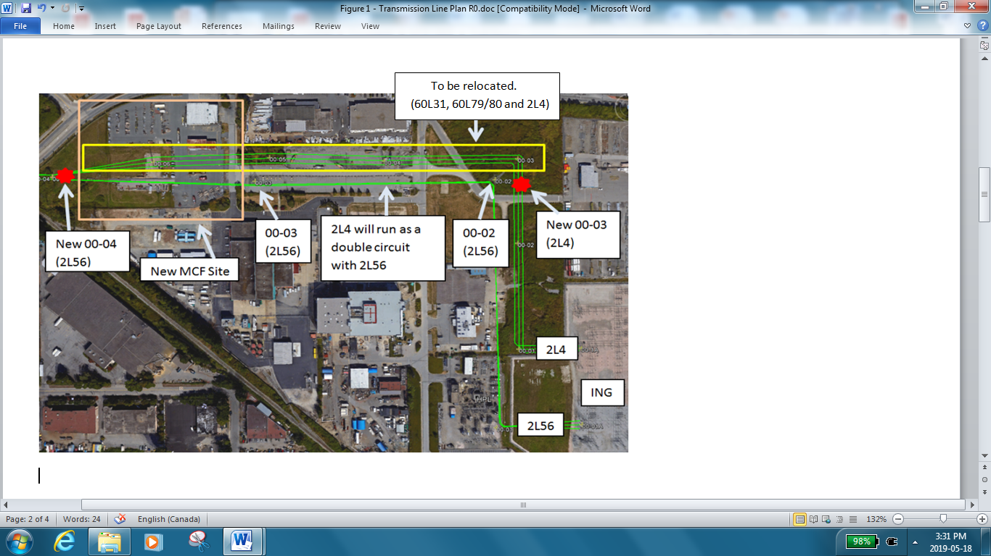
Background

Slide 9
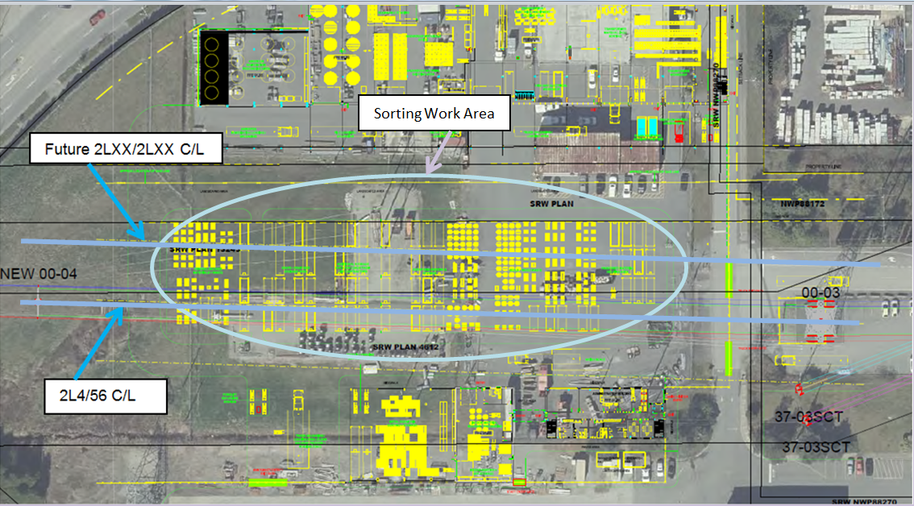
Background con’t

Slide 10
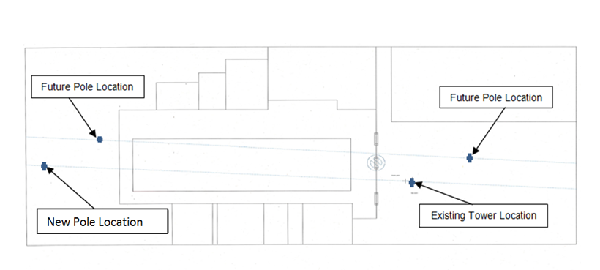
Background con’t

Slide 11
Assumptions
Based on input from the MMBU Project Manager and new facility drawings supplied, plus information obtained during the site visits, the Job Site Hazard Assessment exercise, and other sources, the following is understood that:
the main sorting work area is under the present and future 230 kV transmission lines,
the information regarding work practices, equipment, tools supplied by MMBU staff is completed and accurate,
the work area will surfaced with a minimum of 76 mm (3 inches) of asphalt,
the electrical clearance to the overhead 230 kV conductors will be based on the height of the tallest heavy equipment (25’) used in the sorting work area,

Slide 12
Assumptions con’t
the dimensions of the existing double circuit tower and proposed double circuit steel pole are used for the Induction and EMF studies, plus the conductor, groundwire, structure and line failure hazard assessments,
the thermal current rating of the line of 1000 amperes is used for the Induction study,
the maximum steady state currents for the lines of 1350 amperes and 1220 amperes is used for the EMF study,
the fencing associated with the facility will be standard metal mesh screen type with steel pole supports and barbwire,
the main entrance gates will have card readers and be electric powered,
the main power circuit from the BC Hydro Distribution System for the new MMBU facility is located very near to the east fence where the main gates are located.

Slide 13
Assumptions con’t
for the hazard assessment BC Hydro staff will spend the following time in the work area under the 230 kV transmission lines on foot and could be anywhere is this work space (random distribution assumed) that:
two workers will be on foot 100% of the time for an average of 50% of their work day,
five worker utilizing forklifts for an average of 80% of their work day and being on foot for only10% this time,
each worker puts in150 hours of overtime per year, takes at least 3 weeks of holidays, plus all their SWAP days and Statutory holidays, and
at the present time there seems are no special Personal Protection Equipment (PPE), training or procedures to be required or in place,

Slide 14
Assumptions con’t
for the hazard assessment non-BC Hydro staff, such as truck drivers or other delivery personal will spend the following time in the work area under the 230 kV transmission lines and could be anywhere is this work space (random distribution assumed) that:
these non-BC Hydro workers are on-site making deliveries and pick-ups on average of 200 and 100 times per month, respectively,
these workers are out of the vehicles on foot in the sorting work area rigging or de-rigging their vehicles for an hour on average for each delivery or pick-up, and
at the present time there seems are no special Personal Protection Equipment (PPE), training or procedures to be required or in place.

Slide 15
Assumptions con’t
at least 14 workers (pedestrians) will be walking through the sorting area from one side of the facility to the other via an assumed designated corridor at least four times a day, during normal working hours, and each trip will take 60 seconds per worker,
these three distinct groups of workers will be categorized as BC Hydro Workers (BCHW), Non-BC Hydro Worker (NBCHW) and Pedestrians (PED),
the electrical resistance to ground for the present 230 kV structures has been measured to be used for the present Step and Touch Potential calculations, and the results of these calculations will also be used for the future structures,
the soil resistivity for use for the Step and Touch Potential calculations has been recently completed in the area, and
transmission line failure data from the 2015 CEA Annual Report - Forced Outage Performance of Transmission Equipment will be utilized as the equipment failure frequencies for the hazard assessments. BC Hydro contributes to this data base along with several other Canadian utilities

Slide 16
Assumptions con’t
an N - 1 failure condition for a circuit breaker operation has been assumed with its own corresponding operating time frame,
the frequency of failure data from the CEA 2015 Annual Report - Forced Outage Performance of Transmission Equipment for transmission facilities for circuit breakers will be assumed to be the probability of failure for this equipment and included in the hazard assessment. BC Hydro contributes to this data base along with several other Canadian utilities,
the present and future lines configurations for the various stations associate with this new MMBU facility will be reviewed to determine the appropriate number of possible 230 kV circuit breakers failures to include in the hazard assessment based on the fault level contributions from each station.
This information is connected to the assumption of a circuit breaker failure being part of the fault event and increasing the duration of the fault event.

Slide 17
Assumptions con’t
the locations of the present two double circuit structures are based on the attached MCF Proposed ROW diagram shown above.
the locations of the future second double circuit and their two structures was determined based on the current BC Hydro two double circuit design policy,
the ultimate fault level forecast at the associated substations will be used in the Step and Touch Potential calculations, and
the probability of a significant seismic event to cause the structures or lines or both fail is 1/1000.

Slide 18
Other Activities
The possible Step and Touch Potentials risks associate with the single 230 kV double circuit structures, which will be in place once the new MMBU facility is completed, and the second double circuit lines in the future are covered under a separate Engineering Memo document.
The S&T Potential values determined for the first double circuit 230 kV line will be assumed for the second future 230 kV double circuit as well, to obtain an understanding of the possible impact on future workers.
These Step and Touch values were calculated based on the ultimate fault levels at the MCF site, plus using recently obtained (April 2019) transmission structure footing resistances and soil resistivity measurements for the area around the existing structures.

Slide 19
Other Activities
The circuit breaker information is from the BC Hydro Station Planning’s present and ultimate One Diagrams and Equipment Specification Sheets for the stations associated with the present and future lines configuration, plus the stations’ Operating One Line Diagrams,
These ZoE calculations were also undertaken assuming an N - 1 condition that a circuit breaker fails to operate and the next level of fault clearing activities occurs.

Slide 20
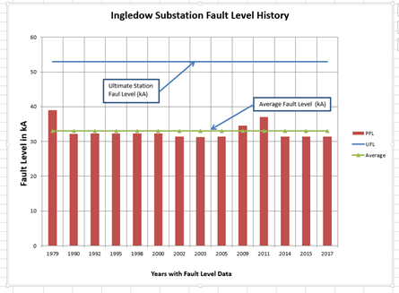
Other Activities

Slide 21
Other Activities

Slide 22
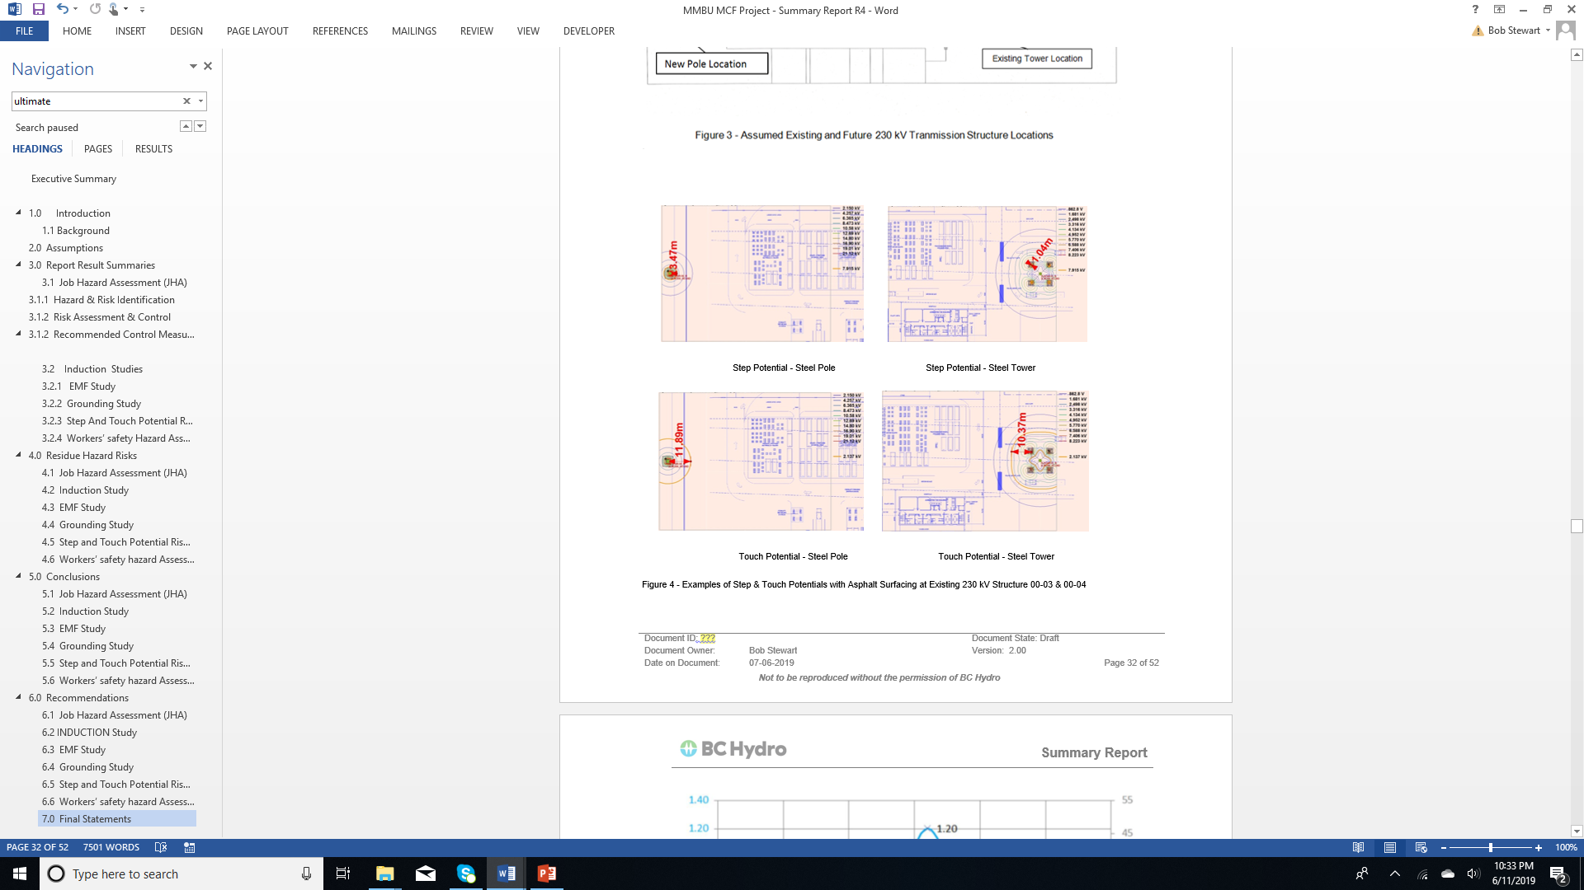
Other Activities

Slide 23
Other Activities
It should also be noted that a Job Hazard Assessment (JHA) was also undertaken by Safety Engineering for completeness, and that the results of this assessment, which is centered on the work being done, will be presented in a separate Safety Engineering Memo.

Slide 24
Other Activities
The results of all these assessment were coordinated with the other six Engineering Memos on this topic:
a Job Hazard Assessment (JHA)
two Induction studies
an EMF study,
a Step and Touch Potential study
an assessment in terms of worker risk for the Step and Touch Potentials and,
an assessment in terms of worker risk for conductors (load conductor or groundwire) dropping or a complete structure or structure/line failure.
These seven Engineering Memos will be compiled in this Engineering Report, which will summarize their results, conclusions and recommendations.

Slide 25
Descriptions of Studies - JHA
The JHA includes 12 entries for the existing material handling work as well as 18 additional entries for performing this work on a transmission ROW. The latter are the focus of this memo and these entries have been coloured white in the JHA for visual differentiation. The 18 transmission risk entries can be summarised as follows, and more details can be seen on the chart given in Appendix A of this summary engineering report:
explosions of compressed gas and flammable gas containers due to fault currents or induced charges or currents,
electrical contact or flashover due to workers, equipment or objects contacting and/or coming too close to the line,
exposure to step and touch voltages due to voltage gradients around transmission structures during fault conditions,
shocks or bites due to induced currents and charges in conductive objects from powerlines,
exposure to electromagnetic fields (EMF),
worker struck by falling transmission structures or conductors.
Many of these items were assessed by Transmission Engineering and the JHA refers to the Transmission Engineering study regarding risk evaluation and control measure identification.
The following Table shows a summary the recommended control measures and accountabilities as a result of the MCF Job Hazard Assessment.

Slide 26
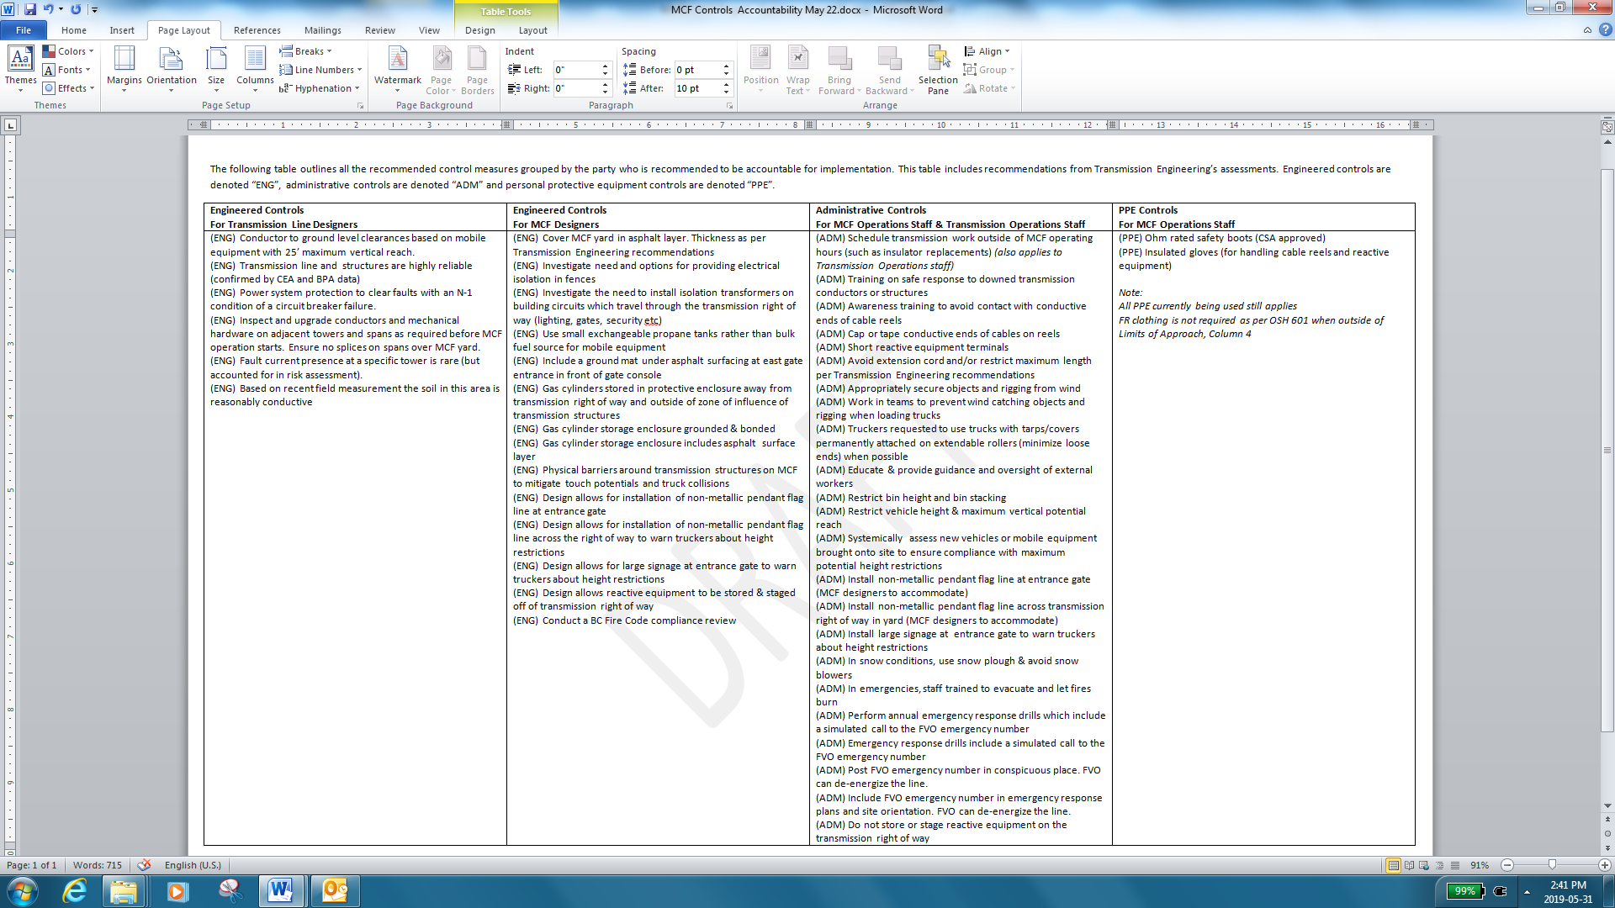
Descriptions of Studies – JHA con’t

Slide 27
Descriptions of Studies
BC Hydro Engineering has been involved in working on a design for relocating circuits 60L31 and 60L79/80 off of the ROW, and rising 2L4/56 to accommodate the new MMBU facility, plus insuring there is appropriate electrical clearance for the tallest piece of heavy equipment used in the new sorting work area.
After some discussion on worker safety associated with the new facility’s working environment in regard to EMF, Induction, Step and Touch Potential during a fault event, and falling conductors or structures during a seismic event, a worker hazard assessment was undertaken to understand the risk associated with the identified potential hazards listed above and their possible impact on workers

Slide 28
Descriptions of Studies
To this end, one of the Engineering Memo undertaken covers the worker hazard assessment for non-electrical workers working under 230 kV transmission lines, and provides information on how the requested hazard assessment was undertaken.
The results of this assessment are presented in terms of annual risk, along with the conclusions determined and the recommendations to mitigate any risk levels determined as hazardous.
It should be noted that EMF and Induction Studies, plus any mitigation recommended for these items will be covered under two additional separate Engineering Memos.
.

Slide 29
Descriptions of Studies
The possible Step and Touch Potentials risks associate with the single 230 kV double circuit structures, which will be in place once the new MMBU facility is completed, and the second double circuit lines in the future are covered under a separate Engineering Memo document.
The Step and Touch Potentials Zones of Exclusion (ZoE) are documented in separate Engineering Memo. These ZoE calculations were also undertaken assuming an N - 1 condition that a circuit breaker fails to operate and the next level of fault clearing activities occurs.

Slide 30
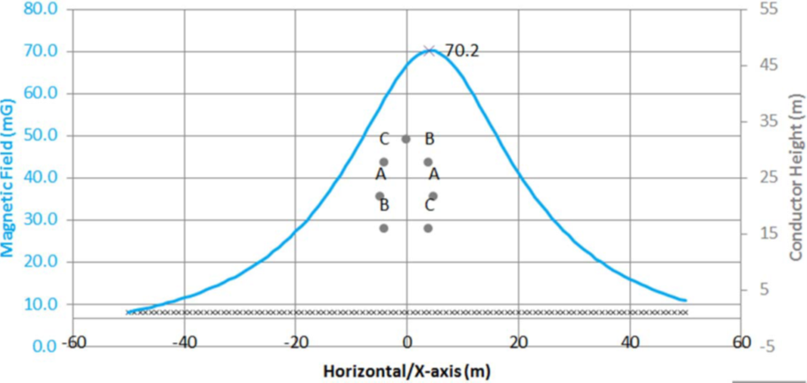
Descriptions of Studies
Electric field profile when 2L4 only is in service
Magnetic field profile when 2L4 only is in service

Slide 31
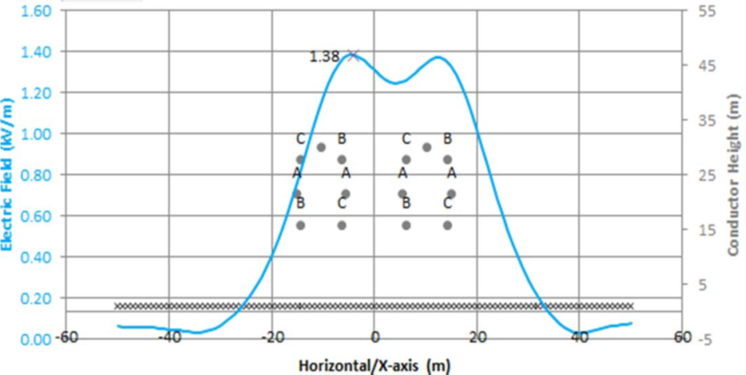
Descriptions of Studies
Electric field profile for the two double circuits adjacent to each other with one Line Only on Each Structure Being Inservice
Magnetic field profile for the two double circuits adjacent to each other with Ling only o Each Structure being inservice

Slide 32
Conclusion by Study
Job Hazard Assessment (JHA)
Locating the MCF sorting work area on a transmission ROW introduces several new risks to the material handling operations work. BC Hydro requires these risks to be controlled.
According to the Hierarchy of Control, the safest option would be to eliminate these hazards by building MCF off of the ROW giving a minimal residual risk level.
If MCF must be built on the ROW, all of the control measures identified in the JHA can be applied which would control the risks down to a moderate or low residual risk level for all risks covered by this assessment, which do not include the hazards covered under the six other studies

Slide 33
Conclusion by Study – Con’t

Slide 34
Conclusion by Study – Con’t
Induction Study
The conclusions of this Induction Study are that:
the maximum allowable length of low-voltage wiring (120 V) within the right-of-way of the 230 kV transmission lines should be 93 m, for this is the worst case with four circuits being in-service. This was calculated assuming a wire that runs in parallel with the transmission lines at the worst possible location,
stored cable reels (cables with insulation) within and near the right-of-way of the 230 kV transmission lines would acquire some induced voltage levels that could be hazardous for the workers,
the maximum height of all light posts is be due to the 230 KV conductor heights at the location of light post and for four circuits in-service, two double circuit lines, the maximum height which can be used anywhere on the MCF site is 7.5 m, and
depending on the proposed location of the light post under the transmission lines the light post could be taller.

Slide 35
Conclusion by Study – Con’t
EMF Study
The conclusion of this EMG Study is that workers working in the sorting work area are not exposed to hazardous electric or magnetic fields.

Slide 36
Conclusion by Study – Con’t
Grounding Study
The conclusion of this Grounding Study is that at least 76 mm (3 inches) of asphalt or equivalent surfacing, approved by BC Hydro Engineering, will reduce the Step and Touch Potential hazard for workers in the sorting work area to as low as reasonably practical. However, other mitigation is required also.

Slide 37
Conclusion by Study – con’t
Step and Touch Potential Risk Study
This hazard assessment relied on the following assumptions and premises:
the proposed facility layout from the MMBU MCF Project drawings provided,
the duration values of the workers (BC Hydro and non-BC Hydro) being under the lines provided by MMBU management,
the proposed layouts of the two existing 230 kV structures after the MMBU facility is complete, and the most probably locations of the two existing structures of the future double circuit 230 kV line,
the recently obtained structure footing resistances and the soil resistivity measurements, which is used for the two future structures also,
the ultimate projected fault level associate with the MMBU facility location, and
the mitigation of a thickness of asphalt can be installed as required on the site, ROW and especially as part of the entrance/exit gates installation, and that this surfacing will be maintained with cracking and crumbling areas repaired or replaced.

Slide 38
Conclusion by Study – Con’t
The following tables, summaries the hazard probabilities and related possible number of worker fatalities for native soil and when a layer of asphalt or equivalent BC Hydro Engineering surfacing is used.
The Step and Touch Voltage Potentials and the possible number of worker fatalities presented in these tables were determined by BC Hydro Transmission Lines Engineering.
The conclusion of this assessment is that at least 76 mm (3 inches) of asphalt or equivalent surfacing, approved by BC Hydro Engineering, will reduce the Step and Touch Potential hazard for workers in the sorting work area to as low as reasonably practical. However, again there are other mitigation requirements besides surfacing.

Slide 39
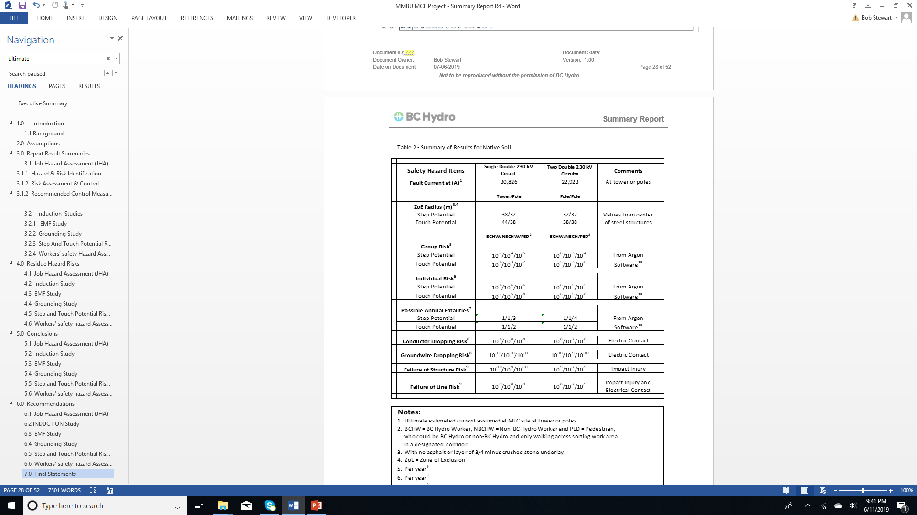
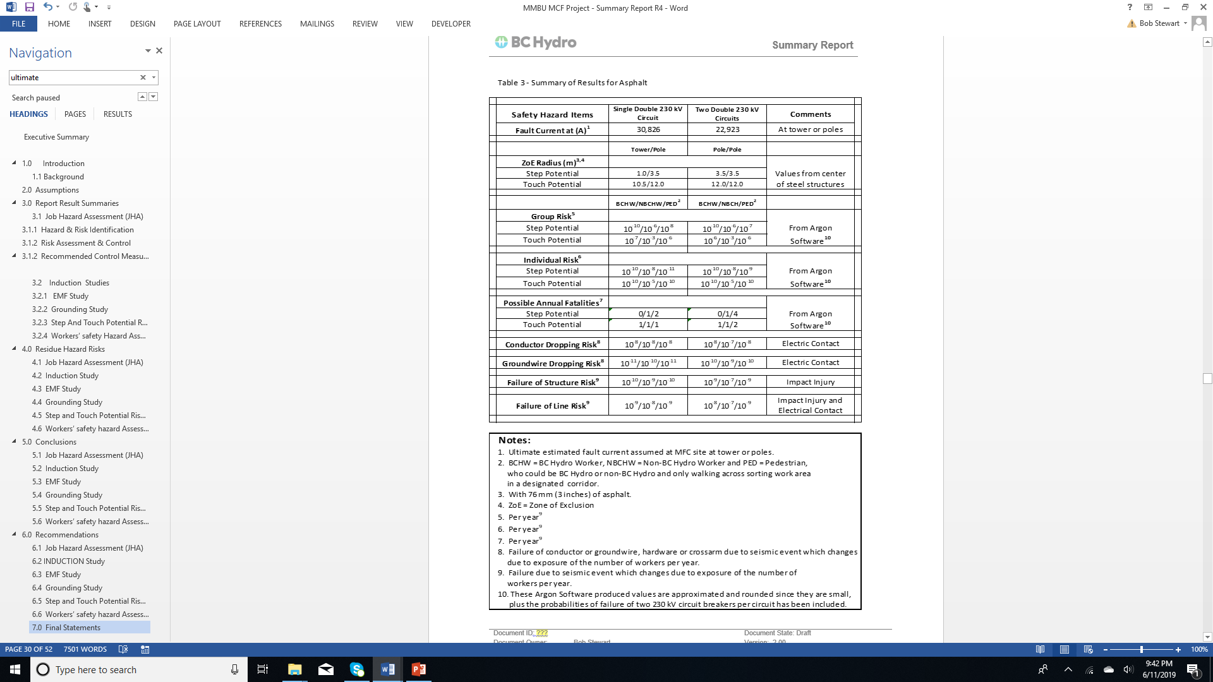
Conclusion by Study – con’t

Slide 40
Conclusion by Study – con’t
This hazard assessment relied on the following assumptions and premises that:
the proposed facility layout from the MMBU MCF Project drawings provided,
the duration values of the workers (BC Hydro and non-BC Hydro) being under the lines provided by MMBU management,
the proposed layouts of the two existing 230 kV structures after the MMBU facility is complete, and the most probably locations of the two existing structures of the future double circuit 230 kV line,
the associated circuit breakers will clear any fault which may occur even assuming an N - 1 operating condition, but in a longer than normal operating time frame,
the probability of equipment and material failures are based on CEA failure data,

Slide 41
Conclusion by Study – con’t
the majority of the fault current will come from Ingledow Substation, so the number of circuit breakers which could fail and lead to a N - 1 condition is only two per transmission line for both the present and future lines or only four circuit breakers per structure being considered,
the worst case zones of influences for the conductor or structural failures will be used, and
the risk of the hazards identified are acceptable, from a worker safety point of view, if they are lower than the low end probabilities of occurrence values shown on the BC Hydro Corporate Risk Matrix (June 2014).
The conclusion of this assessment is that the hazards associated with conductors/structure/line failures for workers in the sorting work area are as low as reasonably practical.

Slide 42
Conclusion by Study – con’t

Slide 43
Recommendations by Study
Job Hazard Assessment (JHA)
To manage the risks of operating MCF on a transmission right of way, Safety Engineering recommends the following:
Implement all control measures identified in the JHA memo. If this is not feasible, Safety Engineering will re-evaluate the residual risks and the suitability of the option to build MCF on the right of way.
Implement a systematic approach to ensure all controls are implemented.
assign the accountabilities for control measure implementation as outlined in Section 6 of the JHA in the Engineering Memo,
MCF project gate reviews are a proactive option to ensure engineered controls are included in drawings prior to release for construction,
an audit at the existing facility can check the correct adoption of administrative and PPE controls prior to migrating to the new MCF, and
a follow up audit can check that administrative and PPE controls were correctly transferred to the new MCF.

Slide 44
Recommendations by Study
INDUCTION STUDY
The recommendations of this Induction Study are:
the maximum allowable length of parallel low-voltage wiring (120 V) within the right-of-way of the 230 kV transmission lines is 93 m,
this was calculated of 93 m is assuming a wire that runs in parallel with the transmission lines at the worst possible location and four circuits in-service. For a more complex wiring system, the MCF site designer is advised to consult a qualified electrical engineer to calculate the level of Induction in the particular wiring system,
stored cable reels (cables with insulation) within and near the ROW of the 230 kV transmission lines would acquire some induced voltage levels that could be hazardous for the workers. In order to minimize the risk, it is highly recommended that the cable ends are always capped properly using non-conductive caps to avoid direct contact with the conductive parts (sheath, core, armors, etc.), and

Slide 45
Recommendations by Study – con’t
INDUCTION STUDY
that the maximum height of all light posts must be limited to the following values, depending on the conductor height at the location of light post:
7.5 m - bottom conductor height is 15 m
8.5 m - bottom conductor height is 17 m
10.5 m - bottom conductor height is 20 m
12.5m - bottom conductor height is 21 m
However, a maximum height of a light post of 7.5 m is recommended for it can be used anywhere on the MCF site, but depending on the proposed location of the light post under the transmission lines the light post could be taller.
.

Slide 46
Recommendations by Study – Con’t
EMF Study
There are no recommendations given in this EMF Study since there are no hazardous worker exposures. However, field measurements prior to construction and after the construction of the relocated existing lines and after the installation of future lines to confirm this study’s results are recommended.
Grounding Study
The recommendation of this Grounding Study is that at least 76 mm (3 inches) of asphalt surfacing should be installed on the sorting work area and roadway, plus other mitigation as stated in below.

Slide 47
Recommendations by Study – Con’t
Step and Touch Potential Risk Study
See section below, for the recommendations associated with this Step & Touch Potential Risk Study are included in this section.
Workers’ safety hazard Assessment STUDY
The worker’s safety hazard assessment study and the Step & Touch Potential Risk Study revealed that:
Fortis BC should be approach to see if an crossing permits are required by them for their gas assets on the property,
the weather forecast will need to be checked daily prior to the start of each work day to be aware of any severe weather in the forecast.

Slide 48
Recommendations by Study – Con’t
Workers’ safety hazard Assessment STUDY
from an electrical safety point of view the installation of a thickness of at least 76 mm of asphalt (3 inches) installed on the site or ROW, will mitigate the Step and Touch potential hazard in the work sorting area, in general, to an acceptable safe level. However, an under layer of minimum of 76 mm (3 inches) of compacted ¾ minus high electrical resistance (3000 ohm/meter wetted) crushed stone (i.e.: not gravel), should also be installed to help re-inforce this insulating asphalt surfacing in case of cracking of this layer, assuming this electrical requirement does not compromise the integrity of the roadway design,
assuming the asphalt does not extend to or go beyond Structure 00-04 an alternative is 76 mm (3 inches) of 3000 ohm/m (wetted rating) ¾ minus crushed stone could be installed at least 33 m beyond this structure on all sides of it where the sorting work area ends,
non-metallic fencing of 1.5 m in height at a minimum 2.0 m from all faces of the tower or pole in question must be installed, complete with a lockable excess point, to mitigate the Touch potential at these steel structures,
,

Slide 49
Recommendations by Study – Con’t
Workers’ safety hazard Assessment STUDY
for the metal fence on the east side the MCF property, either fence isolation sections, as per BC Hydro Engineering Standard ES 21-B0062, must be installed outside the Touch Potential ZoE, plus perimeter ground conductors must be installed a distance of 1.0 meter on either side for the metal fence and connected to the metal fence within the Touch Potential ZoE or non-metallic fencing material installed consideration be given to relocating the most northerly gate on the main entrance,
for vehicle traffic to the facility, be moved more to the north to avoid conflict with a structure associated with the future double circuit transmission structure to the northeast of existing structure 00-03,

Slide 50
Recommendations by Study – Con’t
Workers’ safety hazard Assessment STUDY
the requirement for higher insulation or isolation transformers for the wiring, cabling and equipment for the control and operation of the power gates and weight scale (if applicable) due to the Step and Touch Potentials and the possible use of a ground mat at the gate controls of the entrance gates to protect individuals; using this these controls may need to be further investigated because these additional requirements will depend on the final MCF design, layout and systems proposed. Any ground mat installed must be connected any perimeter fence ground conductor installed,
the need for isolation transformers for the underground power distribution system for the property be further investigated, including any lighting or power outlet circuits in the sorting work area,

Slide 51
Recommendations by Study – Con’t
Workers’ safety hazard Assessment STUDY
the risk associated with the conductor or structure failures in the sorting work area is very low and at an acceptable safe level
due to working under live transmission lines, an additional safety requirements is recommended, that all BC Hydro workers need to have the following minimum PPE, i.e.: electrical rated hard toed boots, and as a minimum clean and dry heavy work gloves, in additional to highly visible/appropriate clothing, when working in the sorting work area,

Slide 52
Recommendations by Study – Con’t
Workers’ safety hazard Assessment STUDY
the risk exposure to the non-BC Hydro delivery workers appears be at least 5 to 6 times higher than the BC Hydro workers due to the large number of delivers per month, so as an additional safety requirements, all non-BC Hydro workers need to have need to have the following minimum PPE, i.e.: electrical rated hard toed boots, and clean and dry heavy work gloves, highly visible/appropriate clothing, plus safety training and, as required, work procedures when working in the sorting work area, and
BC Hydro workers and others passing through the sorting work area should be using a designated away from any Step and Touch Potential ZoE and have highly visible/appropriate clothing.

Slide 53
Final Statement
It should be noted that the worker hazard assessments have been complete taking the following into account:
established engineering principles for safety,
internationally accepted engineering standards for overhead high voltage systems,
past precedents and practices,
characteristics of the proposed use and the profile of the people exposed to the hazard,
the same level of care undertaken for the Westhill Stadium in Langford and the Abbotsford Foam Feast Event, and
a state of the art scientific analysis of the risk.

Slide 54
Final Statement con’t
BC Hydro Engineering and MMBU recognize that:
there is the remote possibility of an electrical accident in the vicinity of the present and future 230 kV transmission lines in proximity to the new MMBU facility,
that should such a highly unlikely accident occur it would have been entirely preventable.
However, in the interests of securing the benefits that are gained from the proposed use of the area within the BC Hydro’s ROW that:
the MMBU will implement and maintain a number of physical and non-physical risk reductions, plus
risk control measures with the view to ensuring that the subject work area in regard to non-typical external factors is as safe for worker use as is reasonably practicable under the circumstances.

Slide 55
Questions

Slide 56
Page header – copy only
Optional short description goes here.
Your copy will go here.

Slide 57
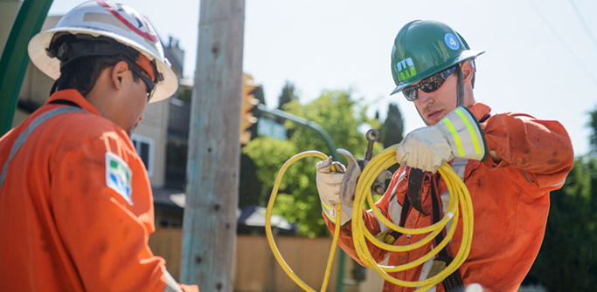
Page header – image only
Optional short description goes here.

